Slide 1
HOTEL MANAGEMENT SYSTEM
-AVNEET SINGH OBEROI
229310248
3A AIML

Slide 2
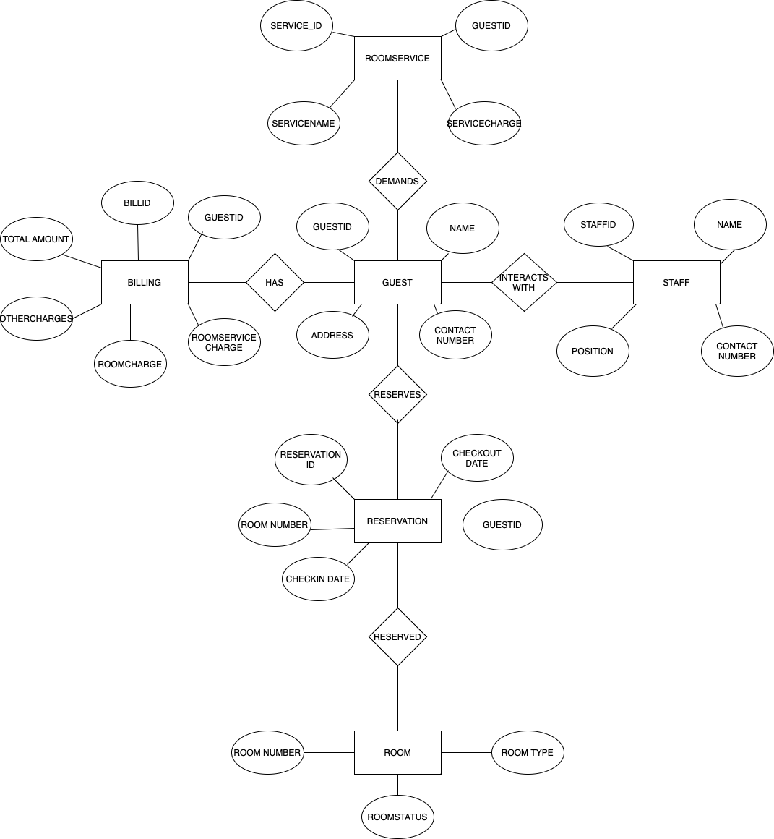
1.ER DIAGRAM

Slide 3
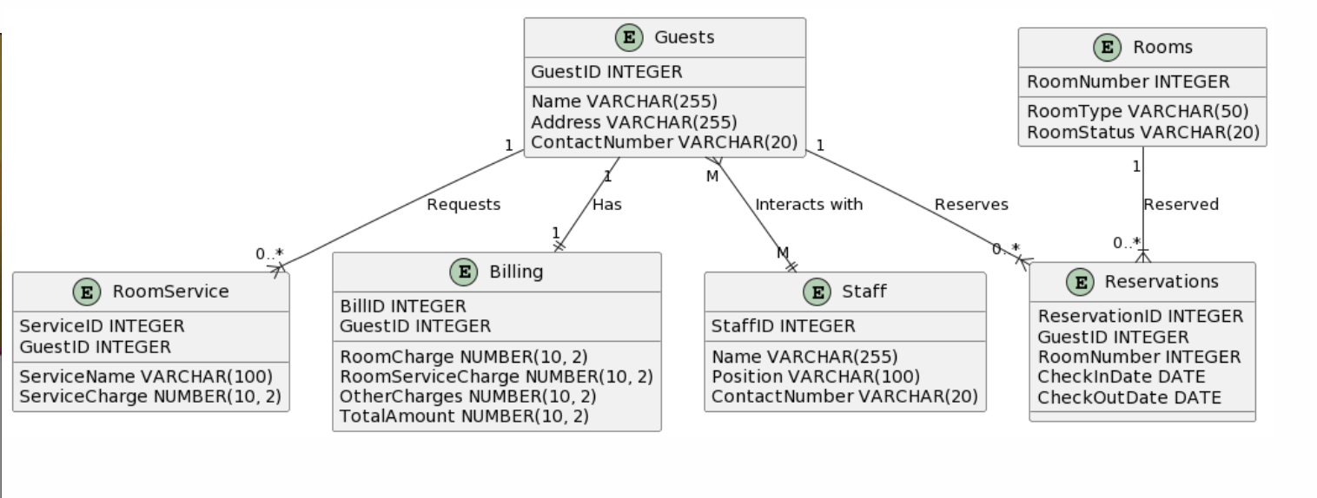
2. SCHEMA DESIGN

Slide 4
3.DATA NORMALIZATION
Database normalization is a process of organizing the data in a relational database to reduce data redundancy and improve data integrity. In this hotel management system project, we can apply normalization to ensure that the database schema is efficient and free from anomalies. Here are the details of data normalization for the project:
1.First Normal Form (1NF):
Ensure that each table has a primary key that uniquely identifies each row.
Make sure that all attributes in a table are atomic (indivisible).
2.Second Normal Form (2NF):
Ensure that each non-key attribute in a table is fully functionally dependent on the entire primary key.
If necessary, create separate tables to represent relationships between entities.
3.Third Normal Form (3NF):
Remove transitive dependencies within tables.
Ensure that non-key attributes are not dependent on other non-key attributes.

Slide 5
For example, iN THIS project:
Reservation table:
ReservationID is the primary key.
GuestID and RoomNumber should be moved to a separate table to represent the relationship between guests and rooms.
Billing table:
RoomCharge, RoomServiceCharge, OtherCharges should be moved to a separate table with a reference to the billing record.
TotalAmount is redundant and can be calculated when needed.
RoomService table:
ServiceName and ServiceCharge can be moved to a separate table with a reference to the guest's room service request.

Slide 6
4.LIST OF TABLES REQUIRED
For a hotel management system project, We typically need a set of tables to manage various aspects of the business. Here's a list of tables that are required:
1.Guest:
GuestID (Primary Key)
Name
Address
ContactNumber
2.Room:
RoomNumber (Primary Key)
RoomType
RoomStatus
3.Reservation:
ReservationID (Primary Key)

Slide 7
GuestID (Foreign Key to Guest)
RoomNumber (Foreign Key to Room)
CheckInDate
CheckOutDate
4.RoomService:
ServiceID (Primary Key)
GuestID (Foreign Key to Guest)
ServiceName
ServiceCharge
5.Billing:
BillID (Primary Key)
GuestID (Foreign Key to Guest)
RoomCharge
RoomServiceCharge
OtherCharges
TotalAmount

Slide 8
6.Staff:
StaffID (Primary Key)
Name
Position
ContactNumber

Slide 9
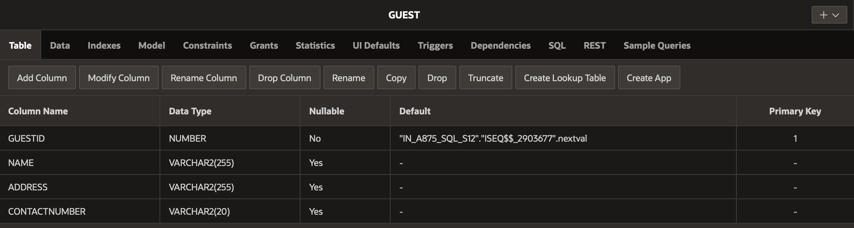
GUEST TABLE

Slide 10
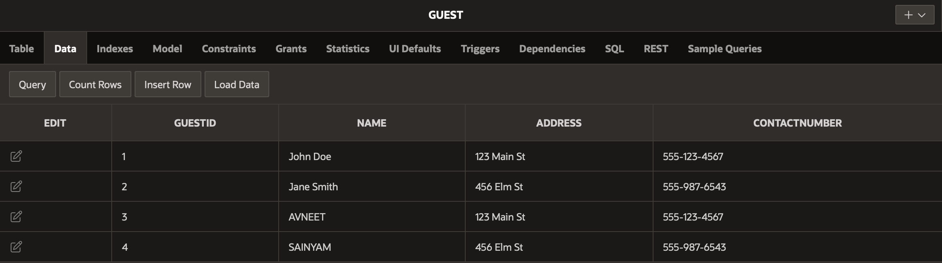
GUEST TABLE(DATA)

Slide 11
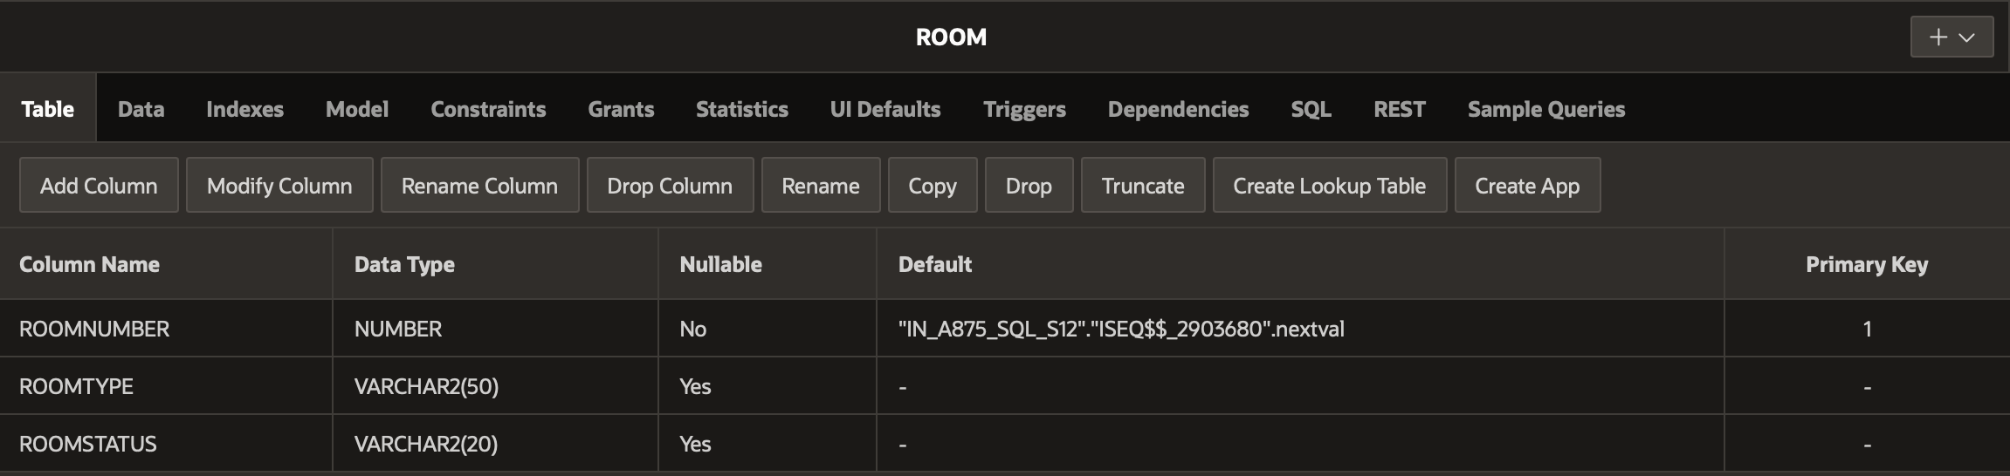
ROOM TABLE

Slide 12
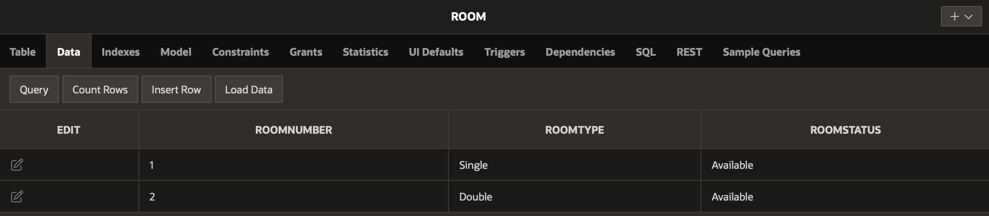
ROOM TABLE(DATA)

Slide 13
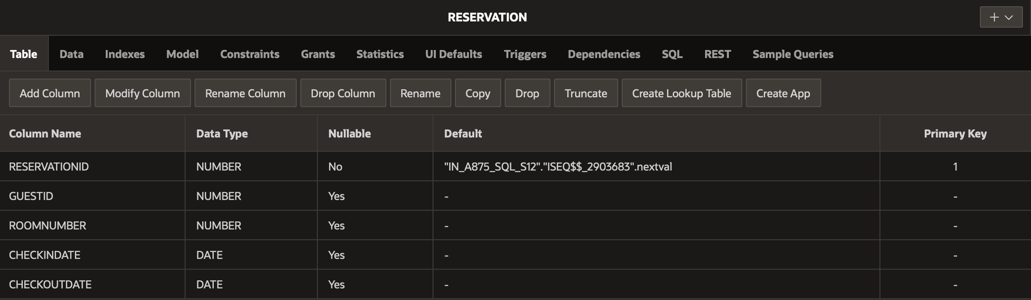
RESERVATION TABLE

Slide 14
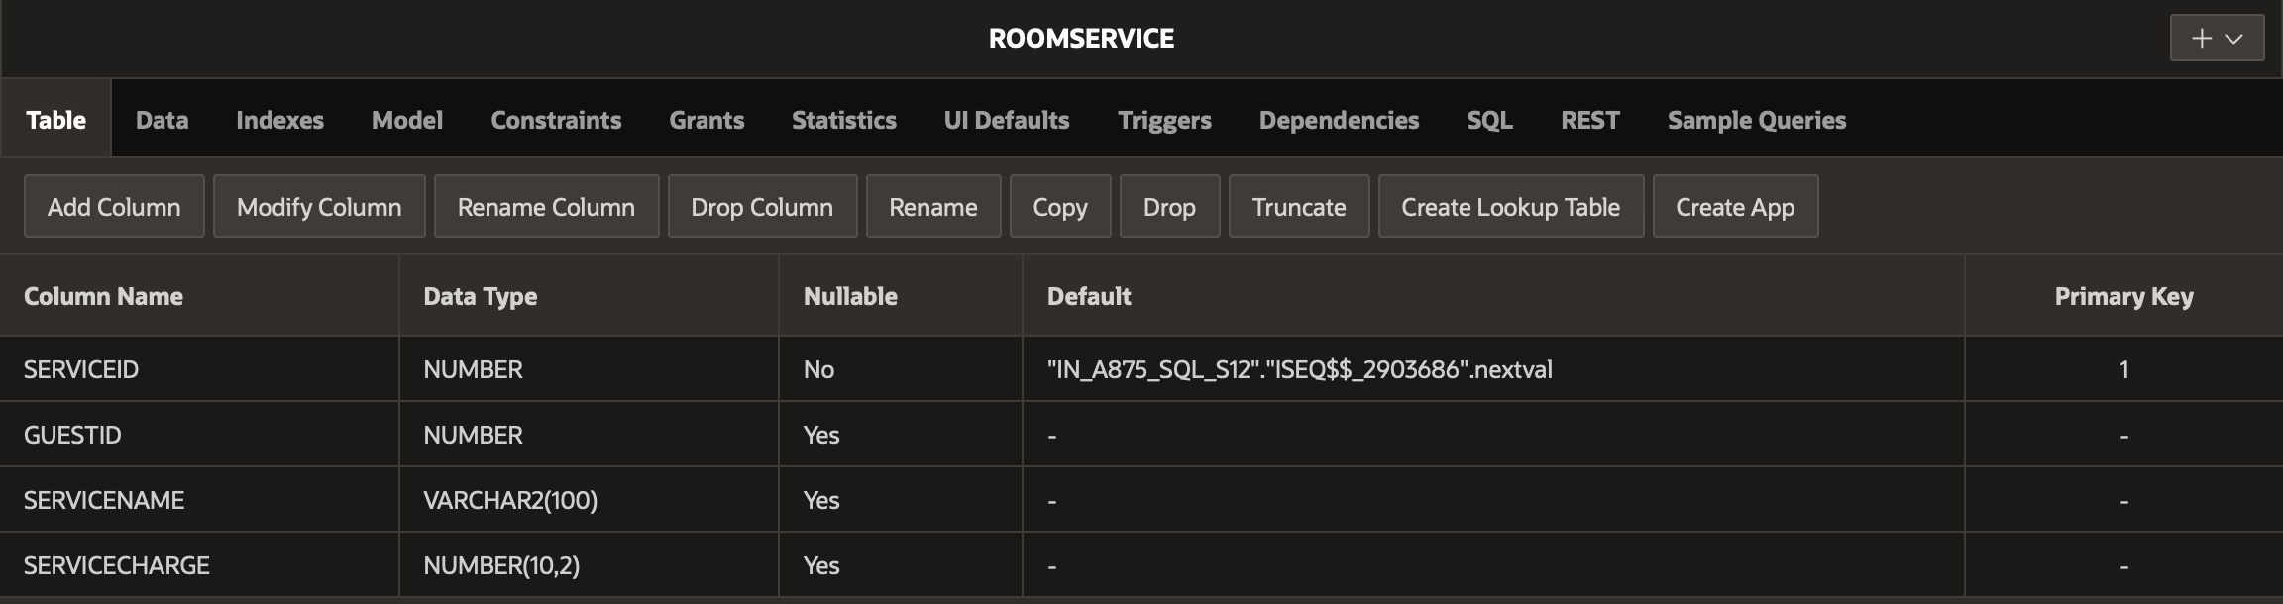
ROOMSERVICE TABLE

Slide 15
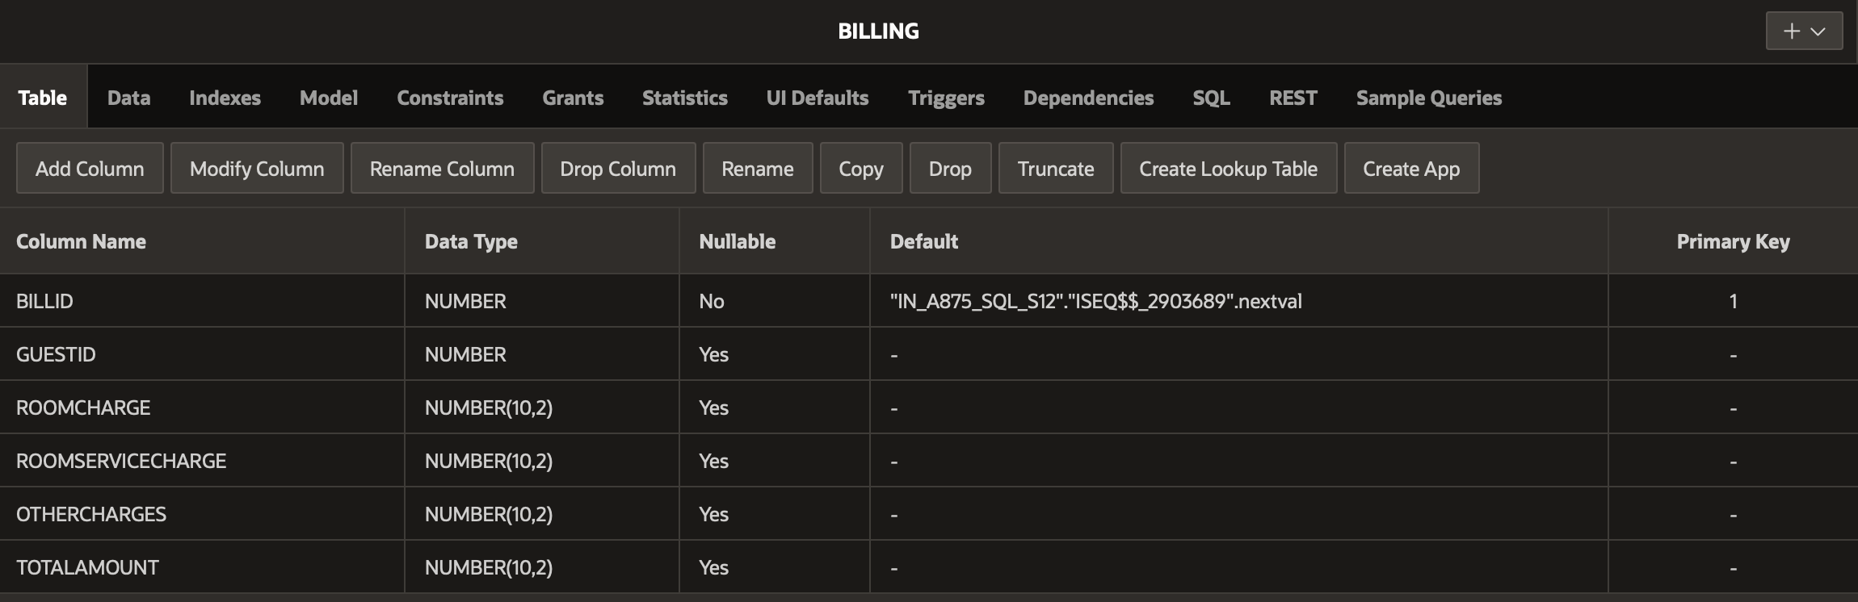
BILLING TABLE

Slide 16
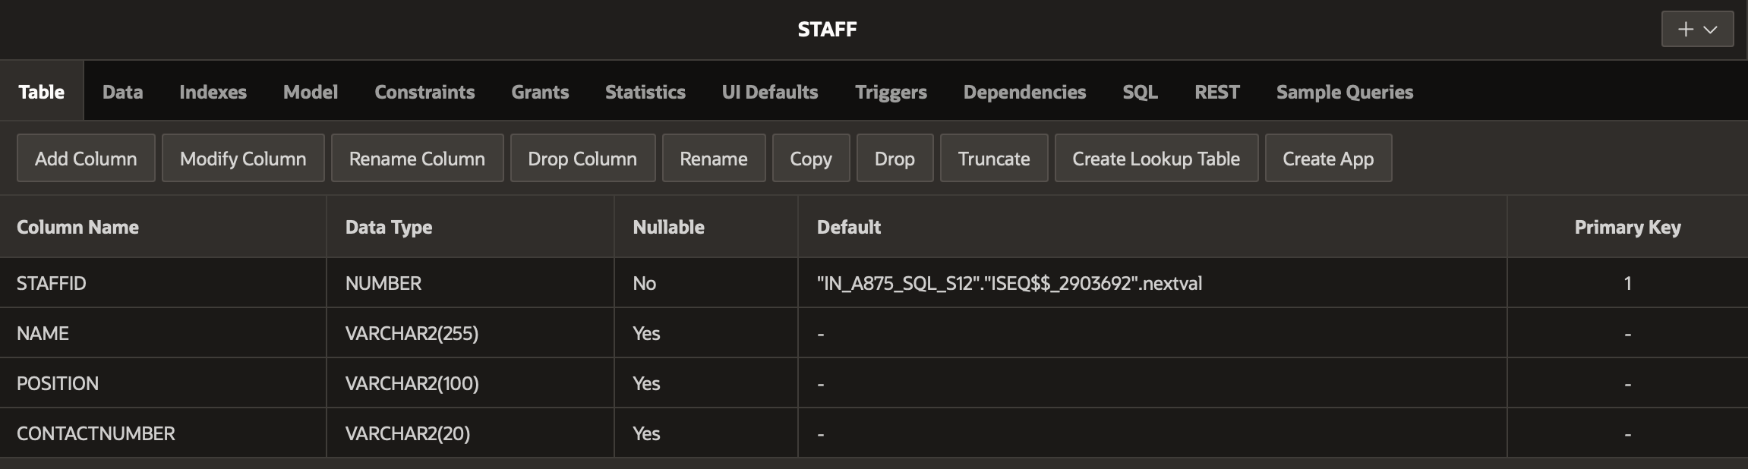
STAFF TABLE

Slide 17
THANK YOU!

